Slide 1

The Internet
Introduction to Networking

Slide 2
The Internet
The Internet is many computers. Some are small, like your cell phone. Some are even smaller, like a router or a Roomba floor vacuum robot or an Amazon Echo.
All of these computers work together to form the Internet. The Internet is a computer network consisting of interconnected networks that use standardized, open (nonproprietary) communication protocols.
The Internet is many computers communicating with one another. They might communicate over radio waves (like WiFi or Bluetooth) or over physical cables (like Ethernet or Cable TV).
One of the remarkable features of the Internet is that the computers connected are not really aware how they’re connected. They are able to communicate over many different kinds of connections.

Slide 3
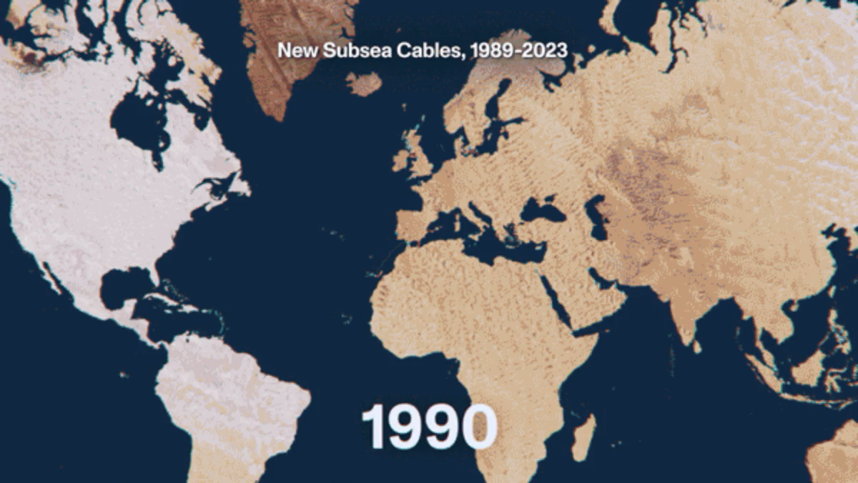
Communicating Across Oceans

Slide 4
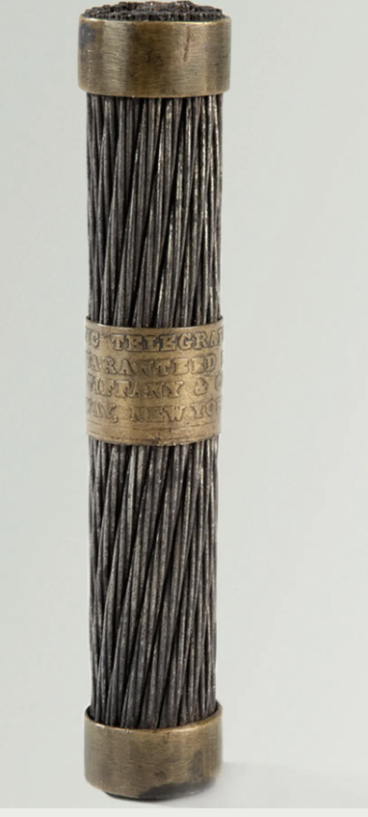

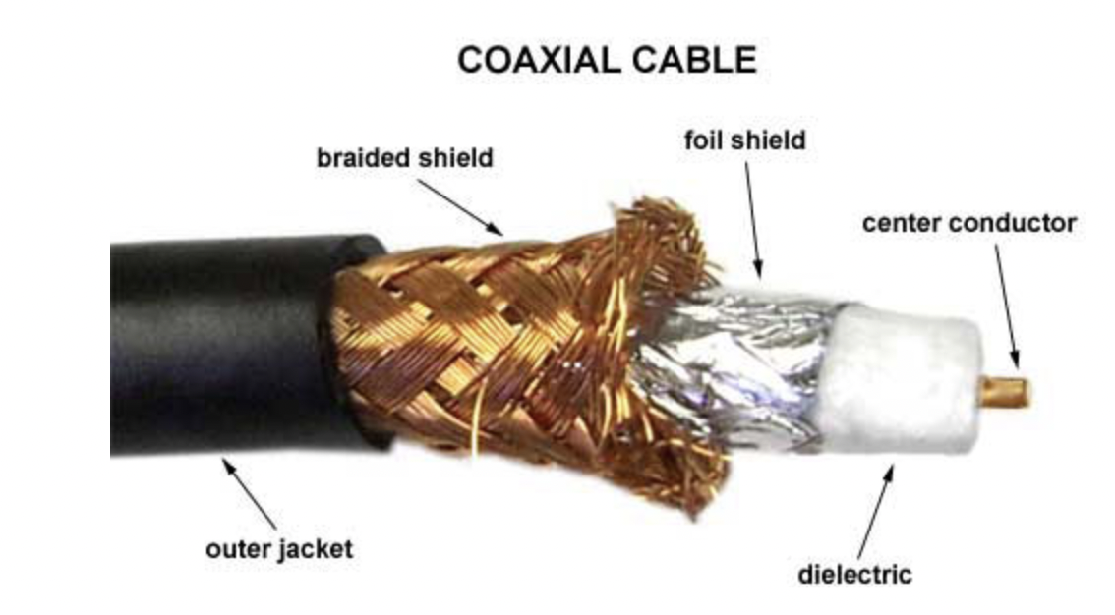
Cables for Connection(optional)
Telegraph cable
coaxial cable
Fiber optics

Slide 5
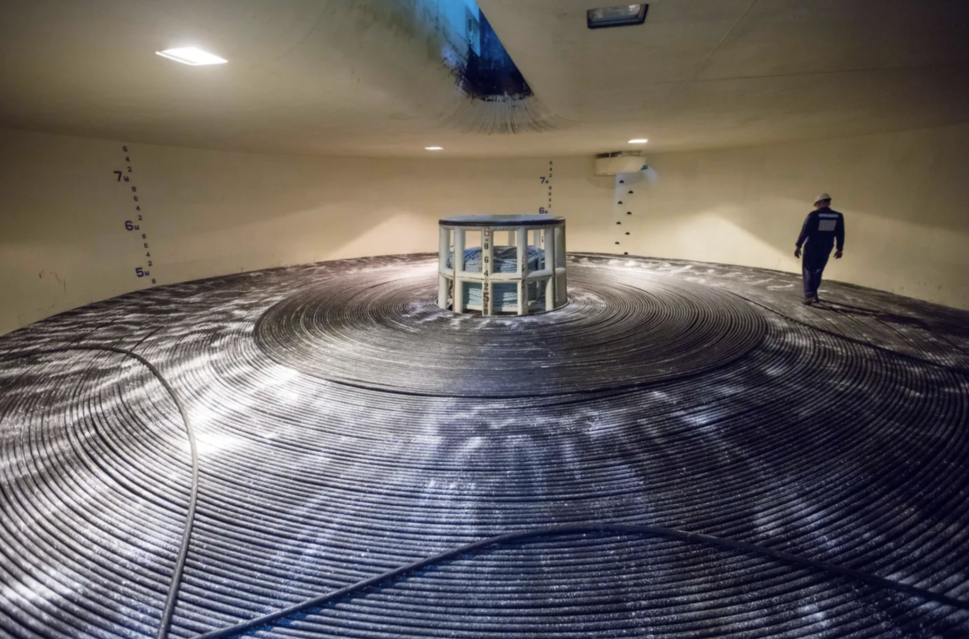
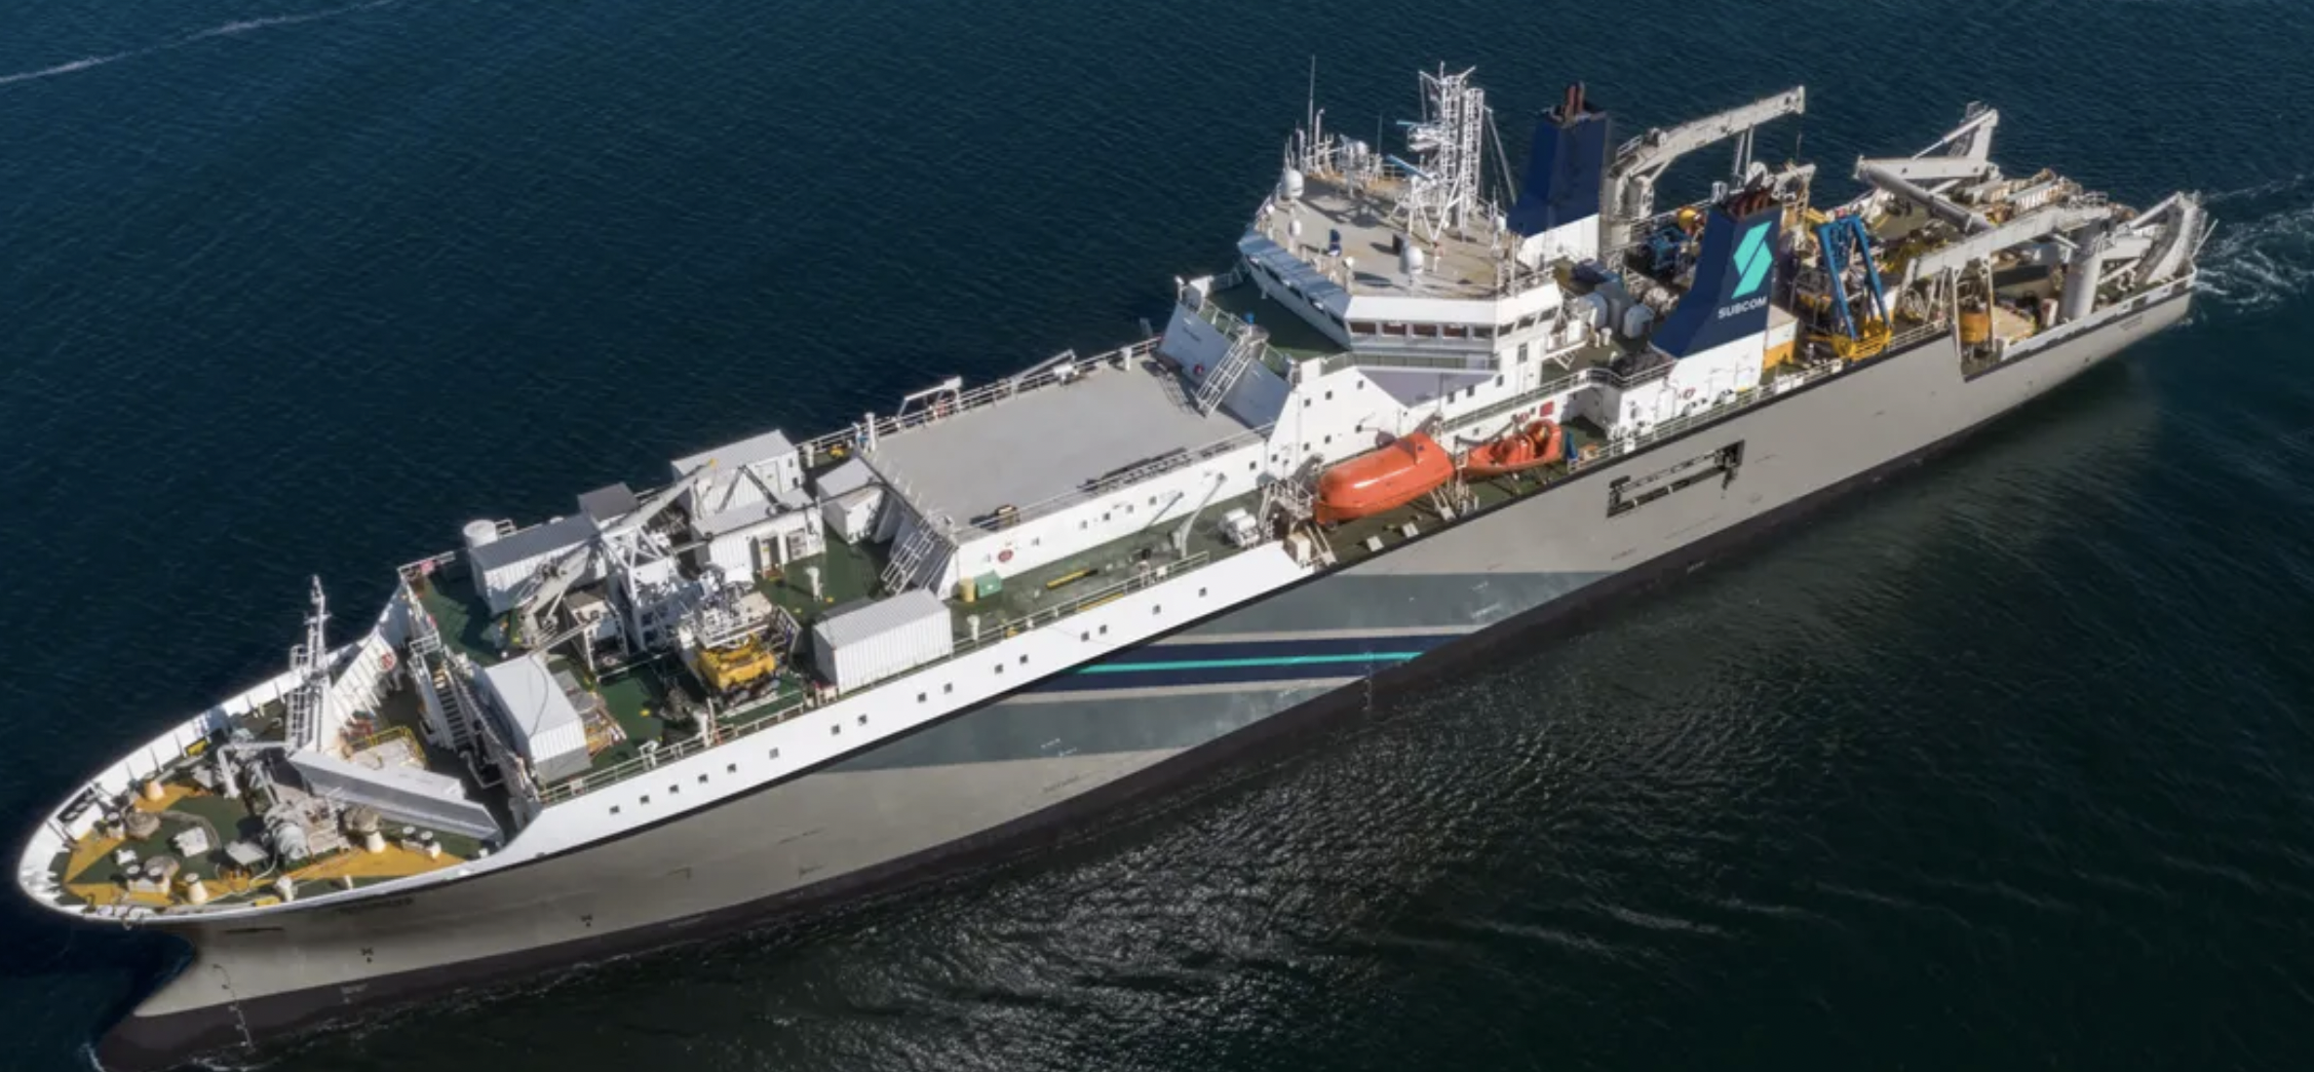
Ship for spooling undersea cable.
undersea fiber optic cable

Slide 6
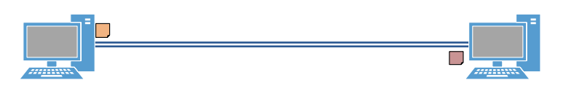
LAN
A computing device is a physical artifact that can run a program. Some examples include computers, tablets and phones.
A computer network is a group of interconnected computing devices capable of sending or receiving data.
local area network(LAN): a group of interconnected computers that share resources in a small geographic area.
Smallest example of a LAN is two computers connected by an CAT6(ethernet cable).
Image:Michael Lamont; www.slideshare.net/MichaelLamont
A host is a computer on a network.
A wide area network(WAN) is a network of connected local area networks. For example, a network at a university campus.

Slide 7

Server-Client
A computing system is a group of computing devices and programs working together for a common purpose. A computer network is a type of computing system.
A path between two computing devices on a computer network (a sender and a receiver) is a sequence of directly connected computing devices that begins at the sender and ends at the receiver.
A client is a computer that is requesting a resource or service.
A server is a computer that provides a resource or service.
Print servers provides printing service, web servers serves webpages, email servers, file servers, etc…
Notes:
David Vignoni from Wiki Commons

Slide 8
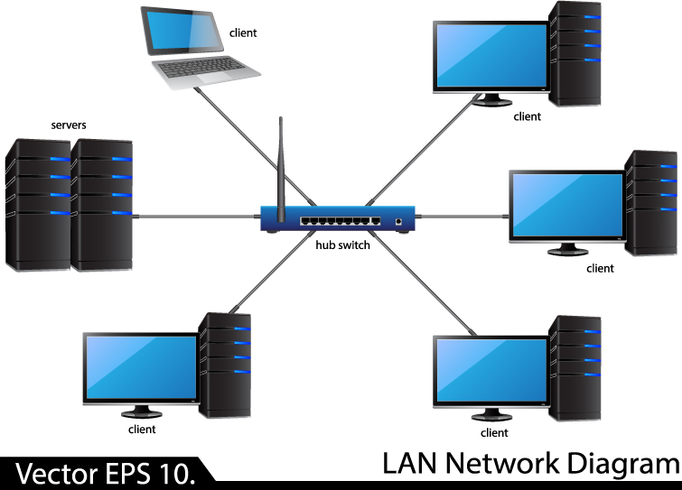
Switches
Switches allow computers on a LAN to communicate with one another.

Slide 9
Switches
A switch is a networking device can forward data directly to computers connected to its ports using the destination physical or hardware address(MAC address).
A port is a physical input/output interface to a networking device.
E.g. a computer sent a request to a printer via a switch; only the printer sees the request.

Slide 10
MAC Address
A network interface card(NIC) on a computer contains a unique hardware address or physical address called the MAC(media access control) address.
Every device that can make Wifi, ethernet or bluetooth connections has a MAC address, e.g., laptops, phones, bluetooth speakers, smart fridge, tablets, etc…
A MAC address is 6 bytes or 48 bits in length. It is displayed in 12 hexadecimal digits.
Example of a MAC address: 00-AA-00-B6-7A-50. The first six digits identify the vendor; in this case 00-AA-00 belongs to Intel.

Slide 11
IP Address
The MAC address provides the physical address for the NIC but provides no information as to its network location, LAN or in which building, city or country the network resides.
Communication between connections on the Internet are governed by rules known as protocols. A protocol is an agreed-upon set of rules that specify the behavior of a system.
The Internet Protocol(IP) address provide worldwide addressing that identifies the computer’s local network.
An IP address is a network address or logical address of a computer.
Can be IPv4 or IPv6. Although IPv6 is becoming more popular, IPv4 is still the addressing technique of the internet.
This is like a street address for your home or school, except, on the Internet, every computer has a unique IP address that only that computer can have.

Slide 12
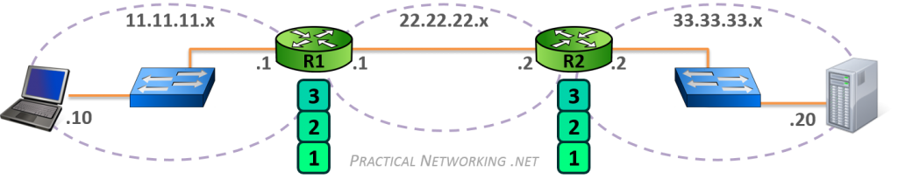
Switch vs. Router
A switch is a networking device that facilitates communication within a local area network using source and destination MAC addresses.
A switch is responsible for hop-to-hop delivery
A data unit sent by a switch is a frame.
A router is a networking device that facilitates communication between networks using source and destination IP addresses.
A router is responsible for end-to-end delivery
A data unit sent by a router is a packet.

Slide 13
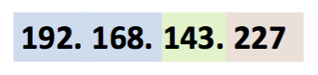
IP Address(IPv4)
The IP address is a unique 32-bit that identifies on which network the computer is located as well as differentiates the computer from all other devices on the same network.
The address is divided into four 8-bit parts. The format is A.B.C.D, where A,B,C,D are decimal equivalent of the 8-bit binary value. Each value is in the range 0-255.
IP address has three parts: network number(identifies the network), subnet and host ID number(identifies the particular computer or host). For example:

Slide 14
IP Address(IPv4)
For IPv4, with 32-bits, there are a total of 4,294,967,296 addresses.
Not a lot of addresses considering the number of tablets, smartphones, smart TVs, Rokus, laptops in each home!
To conserve the public IP address space, private IP addresses are used within private networks. These private addresses are not valid addresses for Internet use.
The three address blocks for private IP addresses are:
10.0.0.0 – 10.255.255.255
172.16.0.0 – 172.31.255.255
192.168.0.0 – 192.168.255.255

Slide 15
Private IP Addresses
In a small LAN, computers/hosts are assigned private IP addresses that can identified them locally.
These private IP addresses are not unique; two hosts from two different LAN can have the same private IP address.
When a computer make a request for a resource outside of its LAN, e.g. CNN’s webpage, the request passes through the router that is responsible for data packets leaving/entering the network.
This router is known as the default gateway.
The Internet Service Provider(ISP) assigns one public IP address to the entire network. Any outside traffic to and from computers inside the network is routed to this public IP address.

Slide 16
Private IP Addresses
When you try opening a website from your computer, the request is sent from your computer with a private IP address to your router, after which your router requests the website from your ISP using the public IP address assigned to your network.
Once the request has been made, the operations are reversed - the ISP sends the contents of the website to the public IP address of your router, which forwards the address to the computer that asked for it.

Slide 17
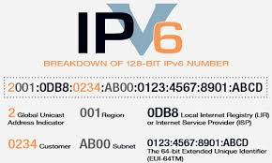
IP Address(IPv6)
For IPv6 uses 128-bits for a total of approximately 3.4x10^{38} addresses.
The address is divided into eight 16-bit parts. The format is 8 groups of four hexadecimal digits.

Slide 18
Network Applications
A network application lets a computer interact with other computers by performing a specific set of tasks.
Browsers, email clients, etc…
The application is responsible for managing the transmitting and receiving of data required to perform its tasks .
The application has to be able to communicate with applications on other networked computers for it to be useful.

Slide 19
The World Wide Web and HTTP
The World Wide Web is a system of linked pages, programs, and files. The World Wide Web uses the Internet.
HTTP(Hypertext Transfer Protocol) is a protocol used by the World Wide for sending/receiving webpages.

Slide 20
Network Applications
A network protocol is a set of rules for how applications intercommunicate.
Common protocols/applications include:
Simple Mail Transfer Protocol(SMTP)
Hypertext Transfer Protocol(HTTP) for sending/receiving webpages
HTTPS(HTTP Secure)
Encrypted with SSL(Secure Socket Layer) or the new TLS(Transport Layer Security) (not on AP)
Secure Shell Access(SSH)(not on AP)
File Transfer Protocol(FTP)(not on AP)
Notes:
Michael Lamont

Slide 21
TCP/IP
Transmission Control Protocol(TCP) is the protocol that is responsible for sending data packets across the internet.
TCP is a host-to-host protocol that provides reliable, connection-oriented communication over IP networks between two endpoints.
A TCP packet is sent using IP addresses, hence the term TCP/IP.
reliable: data received is intact, error-free and assembled in the correct order. Any lost data is retransmitted.
Connection-oriented: Using a system of acknowledgements called the Three-Way-Handshake, two computers confirm the connection before data transmission.
Another protocol similar to TCP is User Datagram Protocol(UDP), which is a connectionless protocol.
Unlike TCP, UDP has no guarantee of delivery or correct assembly. It requires less overhead and is faster. (Skype uses UDP)
.

Slide 22
HTTP
In addition to lower-level protocols such as TCP/IP, there are higher-level protocols (protocols that operate on top of TCP/IP) such as HTTP(send and receive webpages).
Computers on the Internet need to know not only how to send data to each other but also need to know what to do with the data. For example, when viewing websites, your computer is communicating using HTTP (Hypertext Transfer Protocol).
This is also the reason that you sometimes see web addresses begin with an http:// or an https://.
This indicates to the browser to use the HTTP protocol to communicate.
Notes:
Michael Lamont

Slide 23
Packets
The Internet transmits data streams from one computer to another by breaking the data down into small manageable units that are known as packets. This system is called a packet-switching system.
A packet is defined as a small chunk of digital data that contains both a sender address and an address to where the packet is supposed to go.
A single image could contain anywhere from just a handful of packets to upwards of 10,000 depending on a variety of factors.
The process of determining where packets go is called routing or selecting a path for traffic in a network.

Slide 24
Packets
Packet-switching system is similar to traffic routing. Routing on the Internet is usually dynamic; it is not specified in advance.
Each packet contains data to be transmitted, along with metadata containing information used for routing the data.
If a road is becoming too crowded, traffic lights that allow cars to go onto that road might turn red in order to prevent any more cars from coming on.
A road might even be under construction, so no cars are able to enter that road.
Detour signs might route the cars to other roads that are more accessible in order for the cars to get to their destination.

Slide 25
Packets
Similarly, in packet routing, a certain connection might only be able to transfer a certain number of packets per minute, so if the connection isn’t able to transfer them quickly enough, a new path for the packets to go will need to be found by a router. Thus, routing is redundant(more than one way to route data).
Redundancy is the inclusion of extra components that can be used to mitigate failure of a system if other components fail.
Redundancy increases the reliability of the internet and helps it scale to more devices and people.
When a system can support failures and still continue to function, it is called fault-tolerant. If some connection is broken or doesn’t function, the router needs to find a new path for the data to get to its destination, otherwise the packets will never be delivered. Thus, routing is dynamic and fault tolerant.

Slide 26
Bandwidth and Latency
When you have a large system there is going to be latency, however. The latency of a system is the measure of the time it takes for a message to get to its intended recipient from the time it was sent.
Another way to measure a systems effectiveness is with bandwidth. Bandwidth is the amount of data that can be transferred on a system in a certain amount of time.
The amount of data is measured in bits. These days, an average Internet connection speed might be anywhere from a megabit (about a million bits) per second to a gigabit (about a billion bits) per second.
Downloading an email requires less bandwidth than watching a movie on
Netflix.

Slide 27
Name Resolution
Logical IP addresses are “friendlier” than physical MAC addresses, but still aren’t really human readable.
Domain Names: structured, user friendly system names provided by TCP/IP. Examples of top-level domain names:
.com, .org, .edu, .gov, etc…
Name Resolution: the process of mapping logical addresses back and forth into domain names
172.217.204.102 is mapped to www.google.com
Special name servers store the mapping information in databases
TCP/IP’s Domain Name Service (DNS) provides a hierarchy of name servers that handle name resolution for the Internet.
Regular domains are your standard URLs like cnn.com or google.com
Subdomains are a unique URL that lives on a domain as an extension in front of the regular domain like support.somesoftware.com.
Directories are a unique URL that lives on a domain as an extension at the end of URL like apexam.com/webinars

Slide 28
Port Numbers(optional)
An IP address identifies a computer on the internet; a port number is a 16-bit number identifies the application or service on a computer/server.
A port is a logical connection used by programs to exchange information. There are 65536 TCP ports on a computer; each with a 16-bit port number from 0 to 65535. (There are also 65536 UDP ports)
This allows a computer to use different network applications simultaneously. Data packets from different applications use different ports.
E.g. if I have a browser and an email client such as Apple Mail or Microsoft Outlook, then at least two ports are needed for data transfer.
Even within the same webpage request, multiple ports can be used to download the html, images, javascript files, etc… simultaneously.

Slide 29
Port Numbers(optional)
The port numbers in the range from 0 to 1023 are the well-known ports. They are used to identify widely used types of network services.
Port 80 for HTTP, Port 21 for FTP, port 25 SMTP, port 23 for Telnet.
To make a HTTP request for a website, a TCP connection is established.
This connection includes among other things the IP address and port number of the client and the IP address and the port number of the server.
The port number of the client is dynamically assigned to a random port above 1023(ephemeral ports). The port number of the server is one of the well-known port.

Slide 30
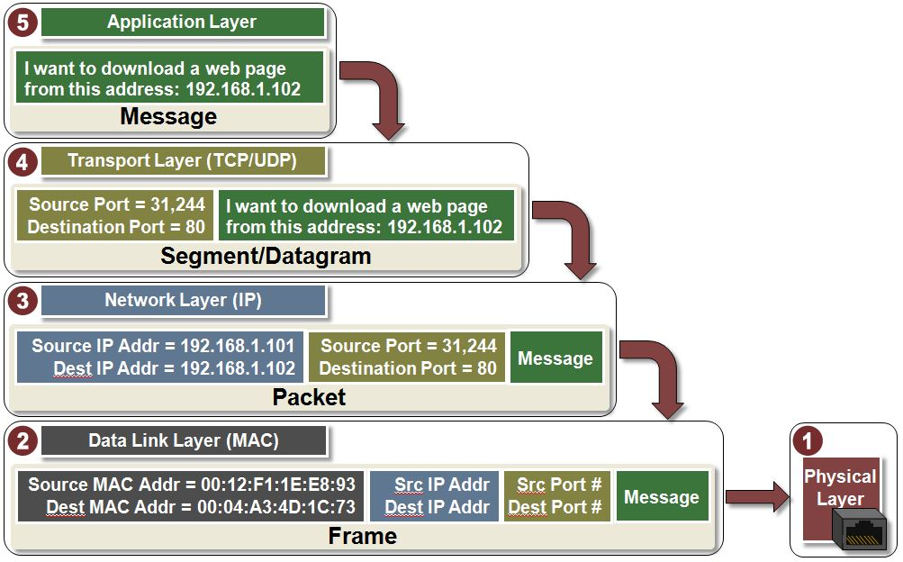
Packets(optional)
Packets contain a chunk of data and metadata used for routing the packet between the origin and the destination on the Internet, as well as for data reassembly.
For example,
HTTP and SMTP
A message that needs to be sent across the internet receives headers from each layer as it travels down the protocol stack. The headers provide metadata such as routing/addressing information, e.g., port numbers, IP addresses, MAC addresses, etc…

Slide 31
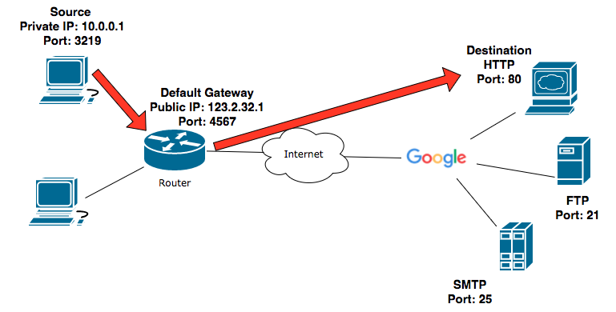
An HTTP Request(optional)
A webpage(HTTP) request from a computer.

Slide 32
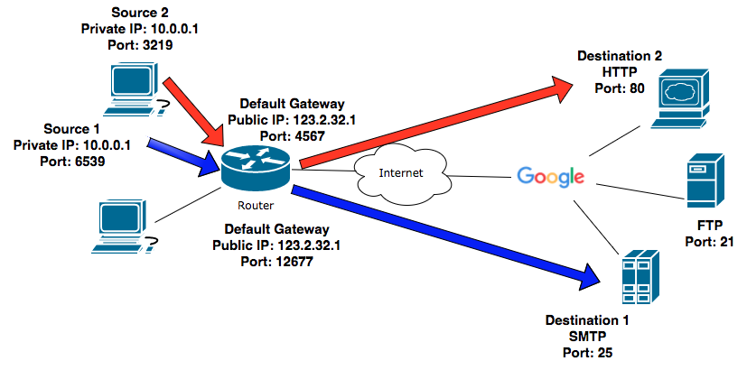
An HTTP Request(optional)
A webpage request and sending an email from the same computer.

Slide 33
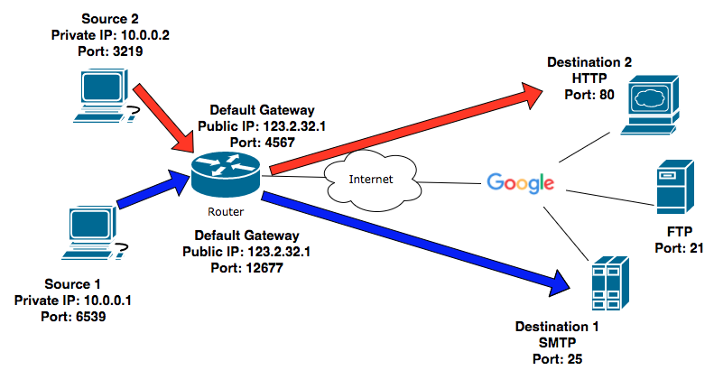
Port Numbers(optional)
Computer 1 sending an email. Computer 2 requesting a webpage. Both computers are in the same local area network.

Slide 34
References
Runestone Academy. CS Principles.
InetDaemon. (2014, September). Networking Tutorials. Retrieved from http://www.inetdaemon.com/tutorials/networking/
Allen, Scott. (2012, January). A Software Developer's Guide to HTTP. Retrieved from
https://odetocode.com/Articles/741.aspx
3) Microchip Technology.(2018). Introduction to TCP/IP. Retrieved from
http://microchipdeveloper.com/tcpip:tcpip-intro-video

